Slide 1


Ethical, Legal, and Social Implications (ELSI)
Korbinian Bösl (he/him)
Data management coordinator
Centre for Digital Life & ELIXIR Norway
27 October 2023

Slide 2
Disclaimer
This is not:
A legal advice
A lecture on research ethics
A reflection on philosophy
Notes:
1

Slide 3
Objectives
How to identify potential ethical issues connected to RDM in my project?
How can some ethical issues in RDM be mitigated?
What regulations, guidelines and laws are connected to RDM in my project?
Notes:
1

Slide 4

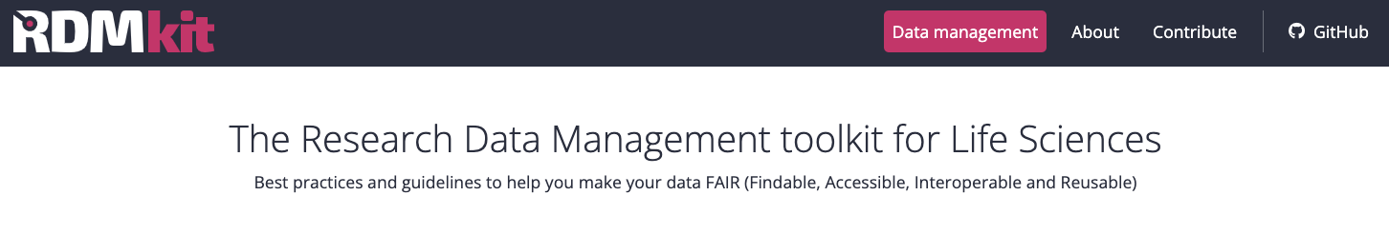
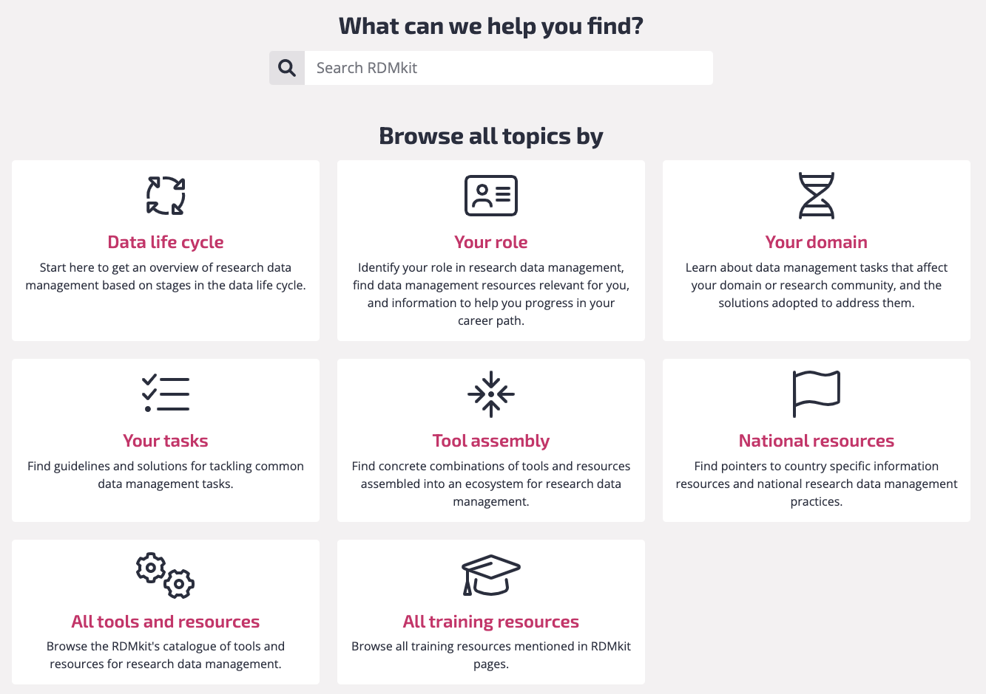

Research
Data
Management kit
https://rdmkit.elixir-europe.org

Slide 5
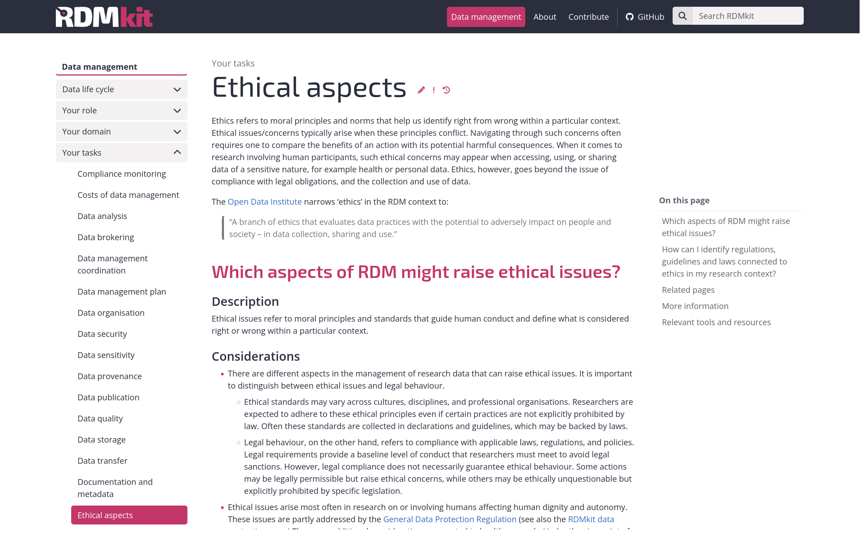

Slide 6
Research
Data
Management kit
https://rdmkit.elixir-europe.org/national_resources

Slide 7

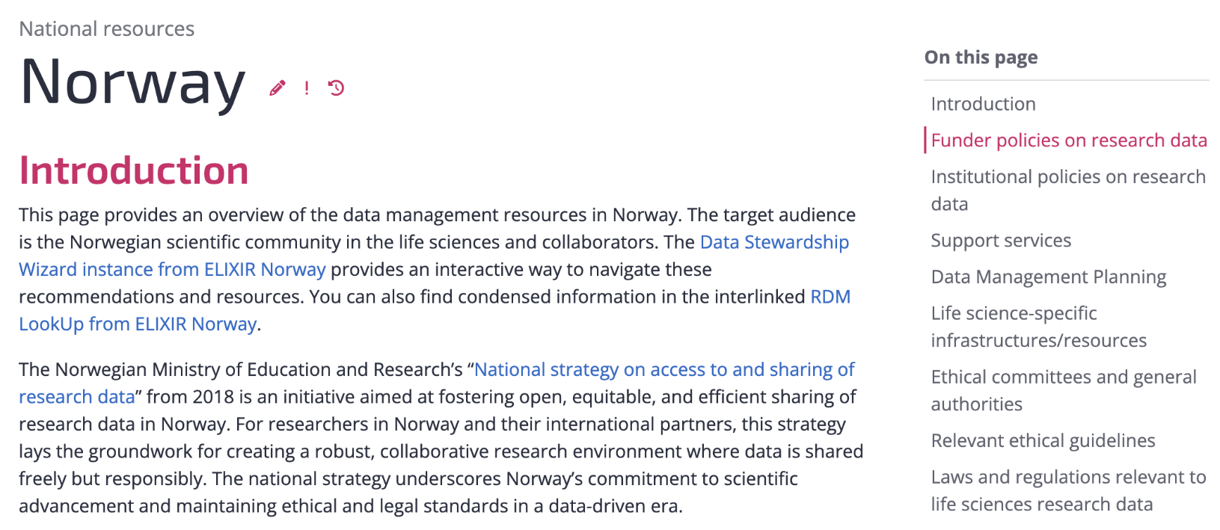
RDMkit: National resources in Norway
https://rdmkit.elixir-europe.org/no_resources

Slide 8
Ethics & Law
Ethical standards
May vary across cultures, disciplines, and professional organisations.
You are expected to adhere to these ethical principles even if not legally enforced
Collected in declarations and guidelines (can be backed by laws)
Legal behaviour
Compliance with applicable laws, regulations, and policies
Baseline level to avoid legal sanctions
Legal compliance does not necessarily guarantee ethical behaviour

Slide 9


In your DMP
3b data security and protection of sensitive data
4 LEGAL AND ETHICAL REQUIREMENTS, CODES OF CONDUCT
4a personal data [...]
4b intellectual property rights and ownership [...]
4c What ethical issues and codes of conduct are there, and how will the be taken into account?

Slide 10

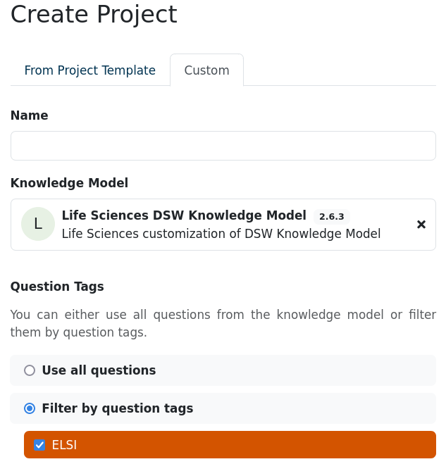
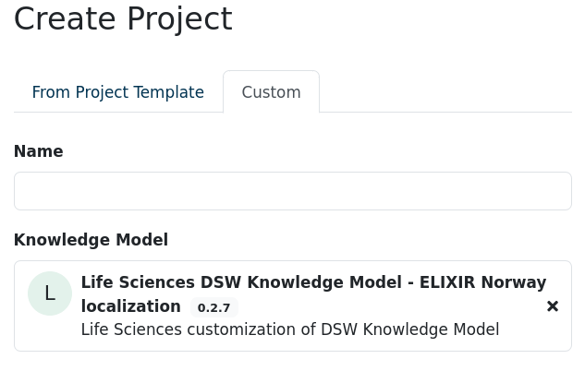
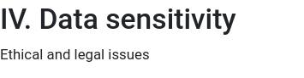

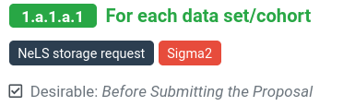

Slide 11
Potential ethical issues in RDM
🧍🩸Research with human subjects
💥 Impact of research outcomes for communities or individuals
🔬 General research ethics considerations reflecting on RDM

Slide 12
🔍 Ethics review
Mandatory for certain types of research (animal experiments, medical research)
Might be integral part of your project
Requires time and might require funding

Slide 13
Responsible Research and Innovation (RRI)
Policy Strong focus from RCN and in Horizon 2020
The idea to anticipate societal impact of research early and make adaptations
Connecting & using different ideas on the relationship of science and society: public engagement, open access, gender equality, ethics and governance
https://rri-tools.eu/about-rri
https://rri-tools.eu/how-tos
https://www.digitallifenorway.org

Slide 14
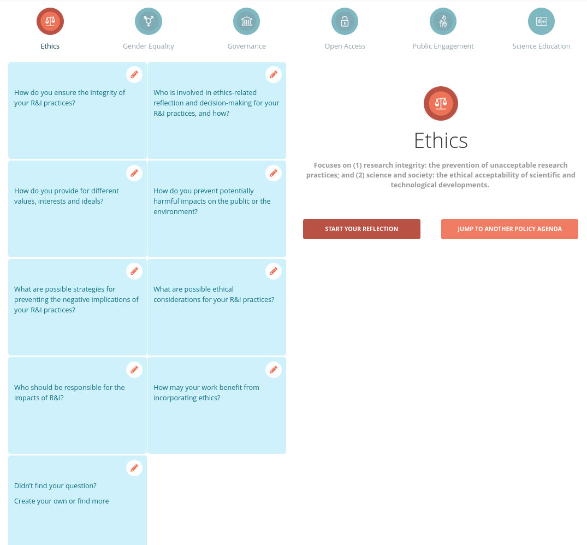
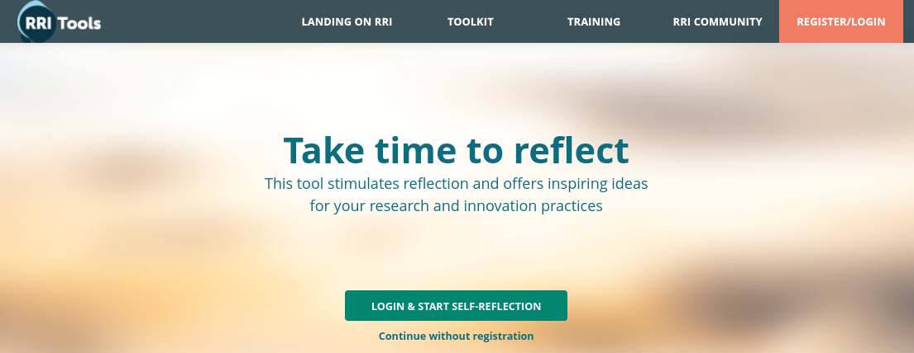
Getting started on RRI
https://rri-tools.eu/

Slide 15

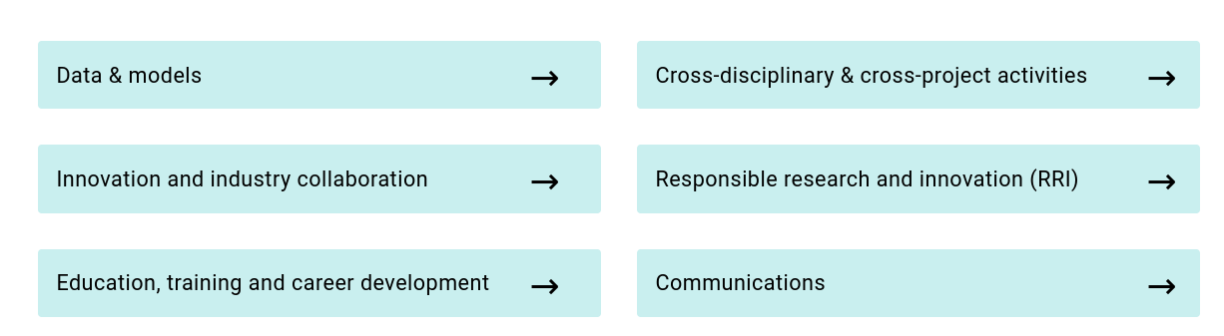
Join us
…as a project
…or Postdoc|PhD
https://www.digitallifenorway.org

Slide 16
🧍🩸Research with human subjects

Slide 17
Handling data connected to humans
Data Psuedonymisation
Anonymous Data

Slide 18


Data Psuedonymisation
“The processing of personal data in such a manner that the personal data
can no longer be attributed to a specific data subject without the use of
additional information, provided that such additional information is kept
separately and is subject to technical and organisational measures to
ensure that the personal data are not attributed to an identified or
identifiable natural person” - GDPR article 4(13)
De-identified and not back traceable for the researcher without the identifier
Pseudonymised data is still personal data!
Notes:
1

Slide 19
Anonymous Data
Anonymous data cannot in any way be used to identify individuals in a data material, either:
  directly by name or personal identification number or
  indirectly by additional information
Not possible for many data types, such as genetic data
Notes:
1

Slide 20
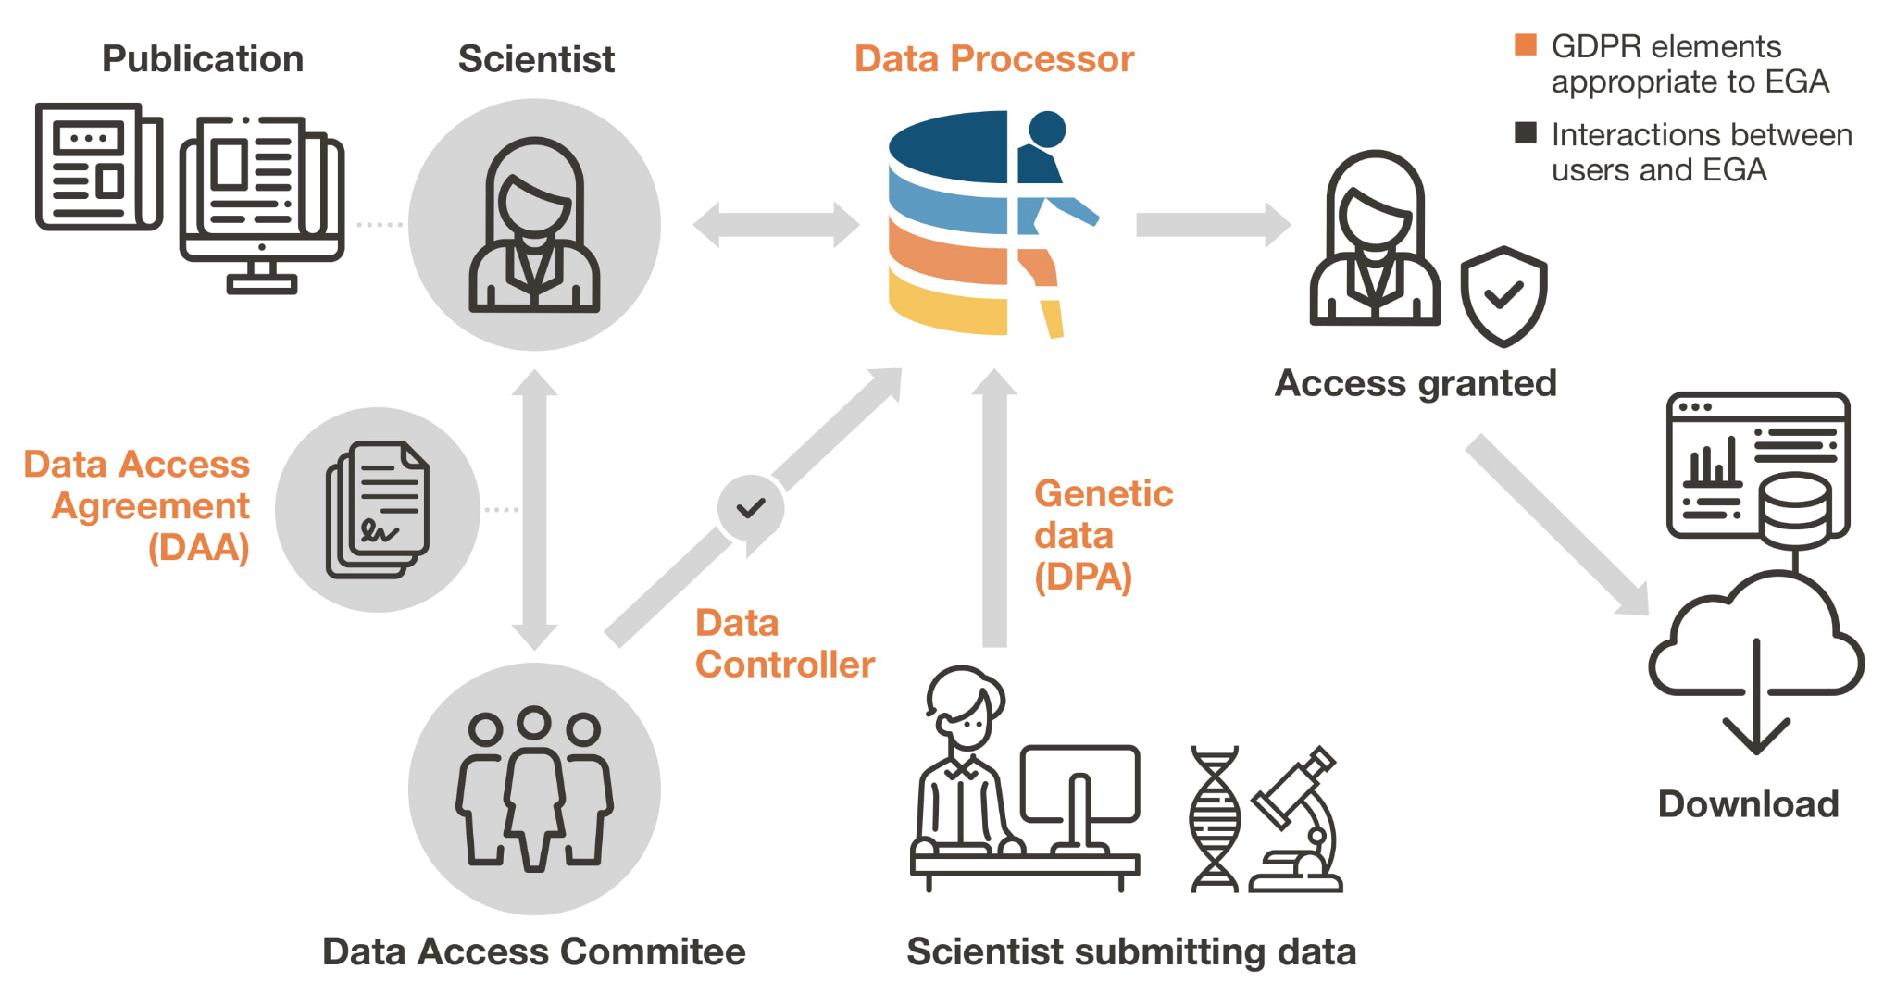
Controlled access data sharing
https://ega-archive.org/

Slide 21
Controlled access data sharing
https://ega-archive.org/

Slide 22
Controlled access data sharing
https://ega-archive.org/

Slide 23
Controlled access data sharing
https://ega-archive.org/

Slide 24
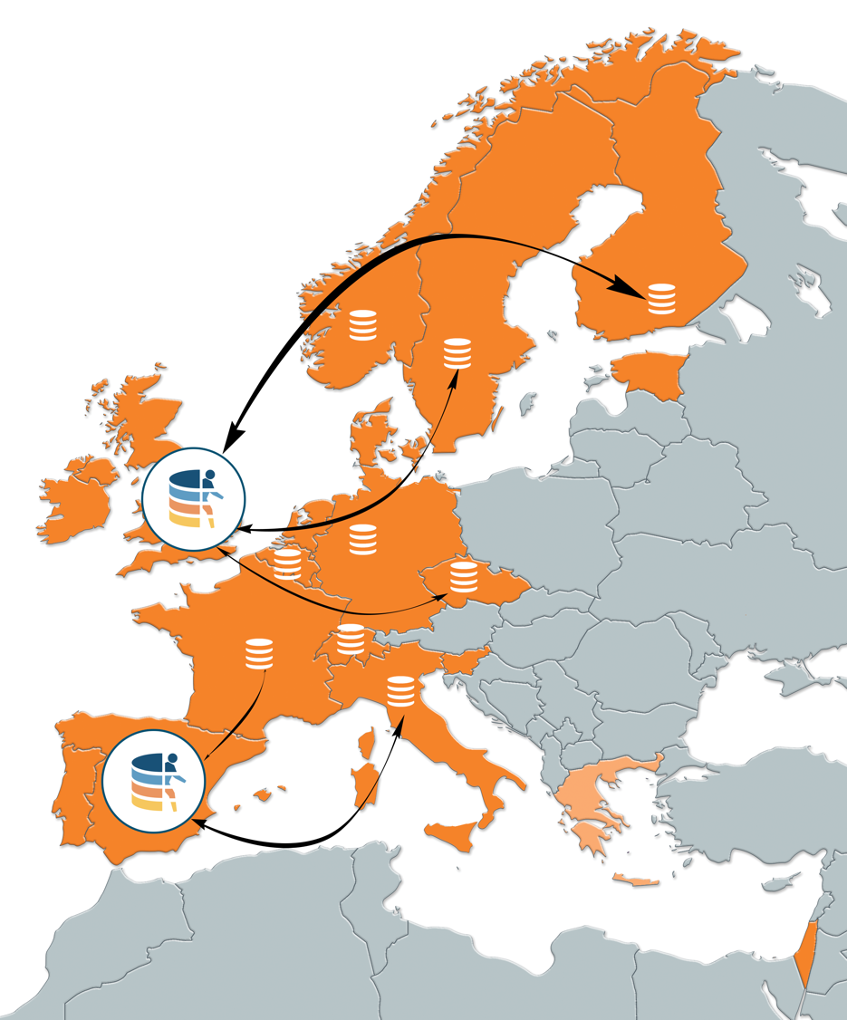



Federated genome/health data across Europe
Many national datasets from human research participants needs to be stored locally
  European Genome phenome Archive (EGA)
ELIXIR developing a federation with shared metadata (FAIR) and local data store (secure)
  Based on suite of interoperable, reusable, adopted, and fit-for-purpose standards
  Norway in piloting role
Linking Federated EGA to national clouds and international access (Life Science login)
17 ELIXIR Nodes involved are part of the Federated Human Data Community
Notes:
Explain EGA
Facilitate cross-border interfaces for meta data while data are
stored in national infrastructures
Enforcing international standards across all submitted
data sets
Applying further standardization on use case
context, for example cancer, common and rare
diseases
Intention is for this to align with 1 Million Genomes Initiative
roadmap

Slide 25

Informed Consent
The consent form is part of the research ethics application
It should include the general principles you will apply on
Scientific Aims/Purpose
Data collection
Data processing/analysis
Data archival
Restrictions for Data Access - e.g. research subjects, geographical (adequacy!)
Controlled Access & Data Access Committees
It should be possible to give granular consent
Also describe already how you will deal with withdrawal of consent or if this is not possible (e.g. due to anonymization)

Slide 26


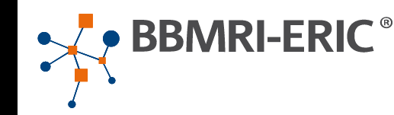
Standard consent clauses
https://www.ga4gh.org/genomic-data-toolkit/regulatory-ethics-toolkit/
https://www.bbmri-eric.eu/elsi/knowledge-base/

Slide 27
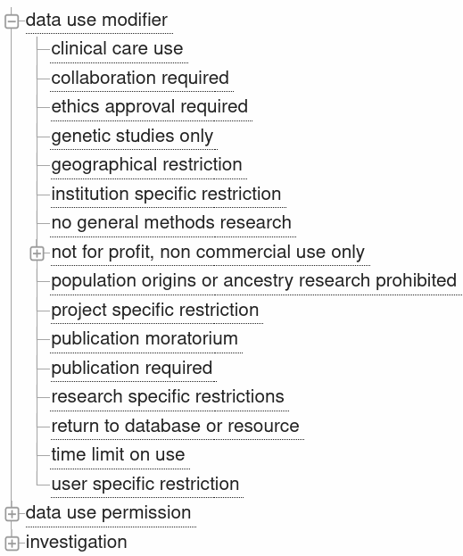
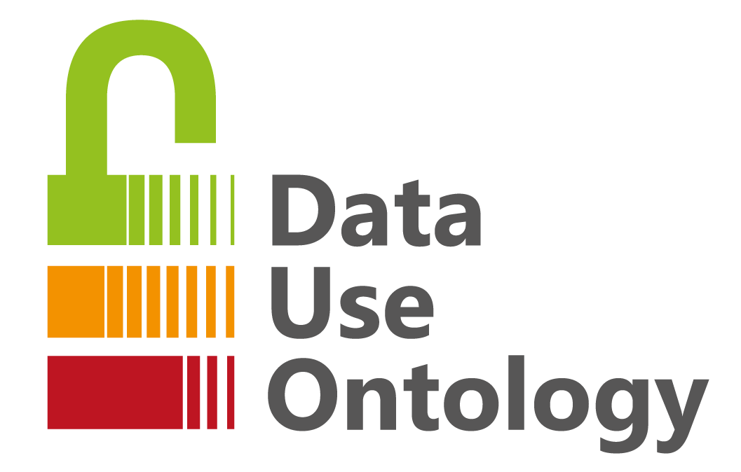

Modelling consents - Data Use Ontology (DUO)
DUO:0000021 ethics approval required
DUO:0000022 geographical restriction
https://github.com/EBISPOT/DUO

Slide 28
Stakeholder involvement
Patient organisations can provide feedback on your RDM (and research)
Safeguarding data subject perspectives in Data Access committee
Transparency on collection, processing, storage,... increases trust
You might have to set off funding & time for this!

Slide 29
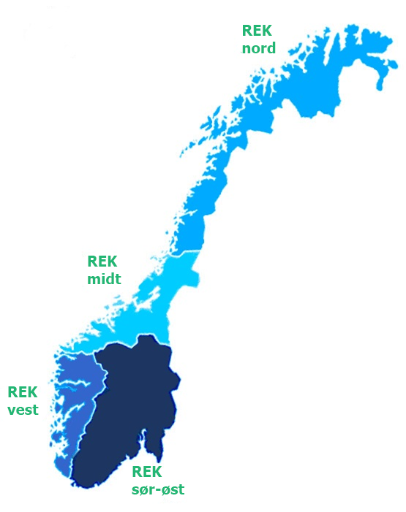

Research Ethics Approval - for Health Research
Should outline:
Consent
Data collection
Data processing/analysis
Data archival
Length of Data storage
Data sharing
Sharing restrictions
Data Access Committee

Slide 30


Important Relevant Legislations
Privacy Act
Research Ethics Act
Health Research Act
Health Registry Act
Biotechnology Act
Archive Act
Health Register Act: https://lovdata.no/dokument/NL/lov/2018-06-15-38
Health Register Act: https://lovdata.no/dokument/NL/lov/2014-06-20-43
Biotechnology Act: https://lovdata.no/dokument/NL/lov/2003-12-05-100
Archives Act: https://lovdata.no/dokument/NL/lov/1992-12-04-126
Archives Act: https://lovdata.no/dokument/NL/lov/1992-12-04-126
Slide adapted from Nazeefa Fatima, 2022 under CC-BY 4.0

Slide 31
💥 Impact on communities & individuals

Slide 32
💥 Impact on communities & individuals
Fair management of intellectual property rights
Publication of research data that might impact the reputation
Publication of research data that might impact security of society -> data classification module

Slide 33

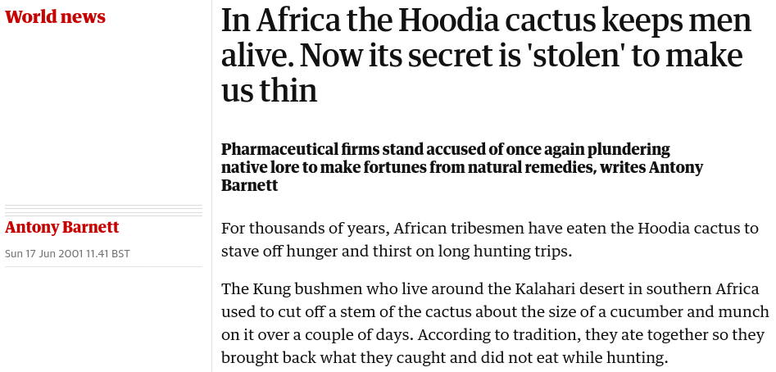

Slide 34
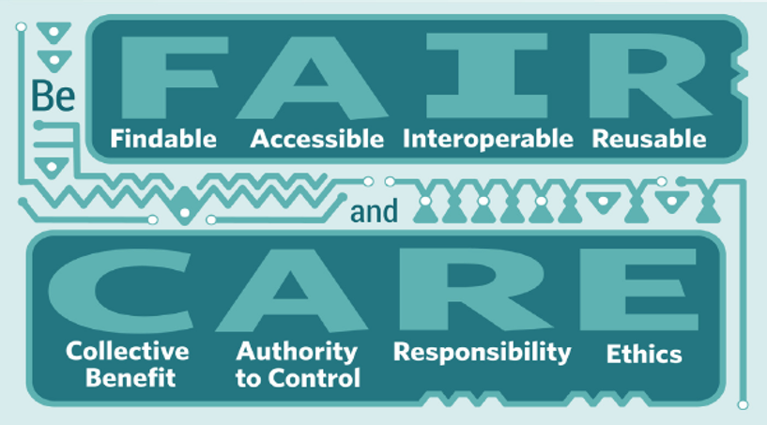

https://www.gida-global.org/care

Slide 35
CARE Principles for Indigenous Data Governance
Collective Benefit.
Data ecosystems shall be designed and function in ways that enable Indigenous Peoples to derive benefit from the data.
C1. For inclusive development and innovation
C2. For improved governance and citizen engagement
C3. For equitable outcome
Authority to Control.
Indigenous Peoples’ rights and interests in Indigenous data must be recognized and their authority to control such data respected.
A1. Recognizing rights and interests
A2. Data for governance
A3. Governance of data
Responsibility.
Those working with Indigenous data have a responsibility to share how those data are used to support Indigenous Peoples’ self determination and collective benefit.
R1. For positive relationships
R2. For expanding capability and capacity
R3. For Indigenous languages and worldviews
Ethics.
Indigenous Peoples’ rights and wellbeing should be the primary concern at all stages of the data life cycle and across the data ecosystem.
E1. For minimizing harm and maximizing benefit
E2. For justice
E3. For future use

Slide 36




Marine Resources Act
Regulation on traditional knowledge associated with genetic material
Nature Diversity Act Chapter VII Access to genetic material
Traditional knowledge associated with genetic resources
1992
2010
2013

Slide 37
Access obligations
[ conditions, legal clarity, consent ]
Benefit-sharing obligations
Domestic-level benefit-sharing measures are to provide for the fair and equitable sharing of benefits arising from the utilization of genetic resources with the contracting party providing genetic resources. Utilization includes research and development on the genetic or biochemical composition of genetic resources, as well as subsequent applications and commercialization. Sharing is subject to mutually agreed terms. Benefits may be monetary or non-monetary such as royalties and the sharing of research results.
Compliance obligations
[ monitoring, enforcement, justice ]

Slide 38
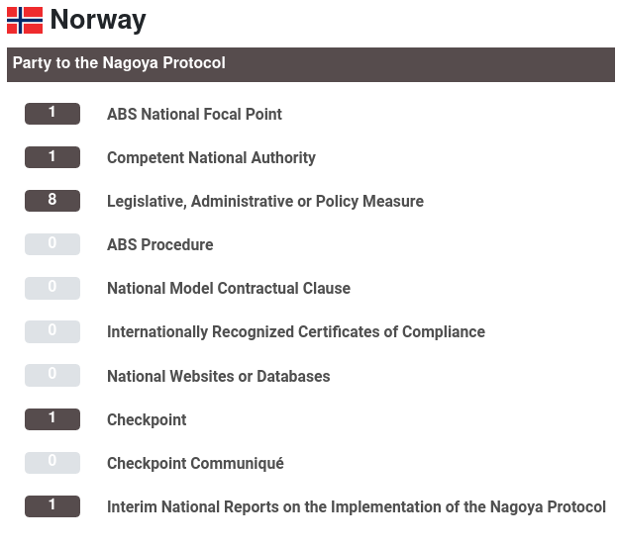

Slide 39
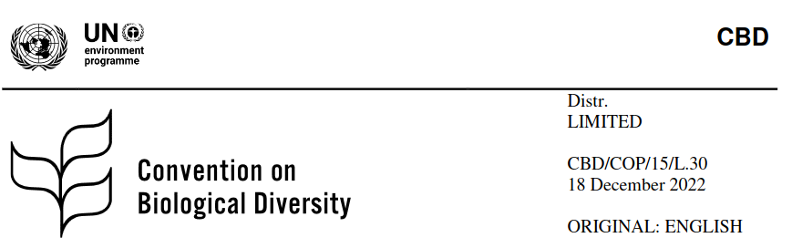
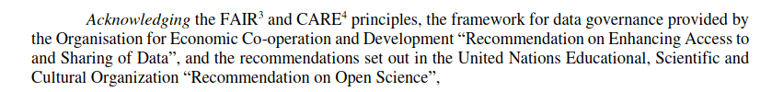
https://www.cbd.int/doc/c/c181/12cf/d29ef8c3f6bd4ec701699d9d/cop-15-l-30-en.pdf

Slide 40
🔬 General research ethics considerations reflecting on RDM

Slide 41
🔬 General research ethics considerations reflecting on RDM
What are the reasons justifying the exclusion/inclusion of research data in a particular context?
Is the data source accurate and trustworthy?
How can bias in practices of research data management be identified and minimised/avoided?
Assessment of models and algorithms used with respect to possible bias
Can the research data be misinterpreted?
Prevention of withholding of research data
Prevention of manipulation and fraud of research data
Assessment of who is excluded or included to data access and why
How can harm to other beings and the environment be identified and mitigated in a timely manner?

Slide 42

Research Ethics Act
Withhold-, mislead about-, or selectively/secretly dispose of undesired results.
Conceal of scientific efforts and / or scientific achievements. Improper allocation of authorship etc.
Destruction of research data / material to prevent investigations of misconduct.
Research Ethics Act: https://lovdata.no/dokument/NL/lov/2017-04-28-23
Notes:
1

Slide 43

Guidelines for the use of genetic studies of humans
General guidelines on research ethics
Guidelines for Research Ethics in Science and Technology
Guidelines for the inclusion of women
Guidelines for clinical trial of drugs
Guidelines for research ethics and scientific assessment of qualitative research projects
Read more at: forskningsetikk.no
Slide adapted from Nazeefa Fatima, 2022 under CC-BY 4.0
Notes:
1

Slide 44
The Vancouver Recommendations
Declaration of Helsinki
Oveido Convention
Otherwise known as: The Convention for the Protection of Human Rights and Dignity of the Human Being with regard to the Application of Biology and Medicine
Read more at: forskningsetikk.no
Slide adapted from Nazeefa Fatima, 2022 under CC-BY 4.0
Notes:
1

Slide 45






Bodies on research ethics
Slide adapted from Nazeefa Fatima, 2022 under CC-BY 4.0
Notes:
1

Slide 46

Thank you!
elixir-norway.org
digitallifenorway.org
contact@elixir.no
contact@digitallifenorway.org
korbinian.bosl@uib.no
@elixirnorway
@DigitaltLiv
@BoslKorbinian
Except where otherwise noted, this work is licensed under a
Creative Commons Attribution 4.0 International License
https://creativecommons.org/licenses/by/4.0/
Notes:
1

